Slide 1
CAREER PLANNING
A career planning may be defined as ‘a sequence of jobs that constitute what a person does for a living.
According to Osborn-’ Career planning is a process of systematically matching career goals and individual capabilities with opportunities for their fulfillment.

Slide 2
Career stage
Career Path
Career Anchor
Career Choice

Slide 3
CAREER DEVELOPMENT
Career development is the lifelong process of managing learning, work, leisure and transitions in order to move toward a personally determined and evolving preferred future.

Slide 4
CAREER PATH
Career path refers to the growth of the employee in an organization

Slide 5
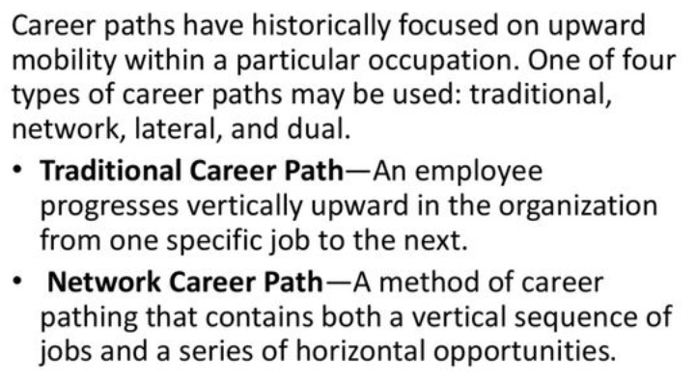

Slide 6
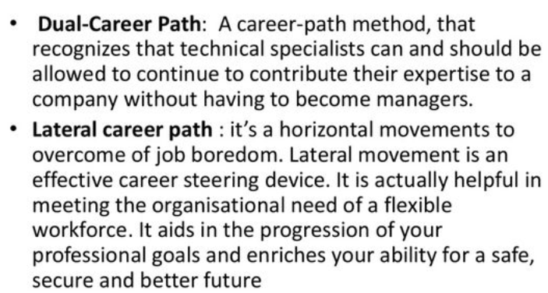

Slide 7
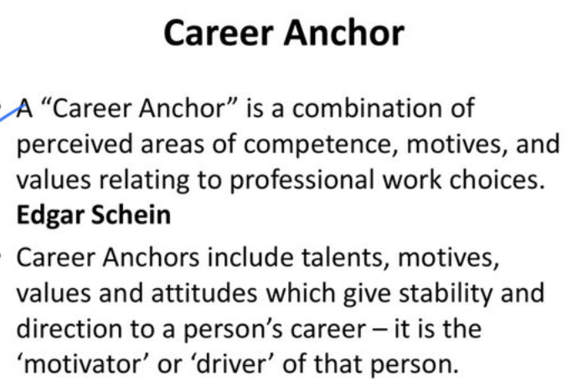

Slide 8
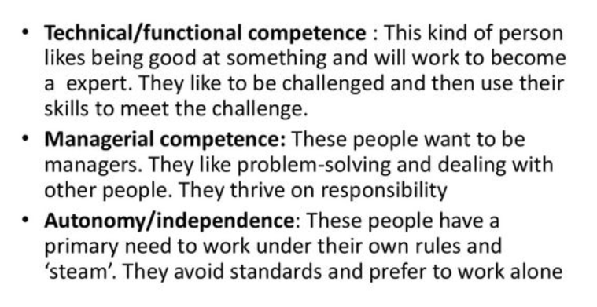

Slide 9
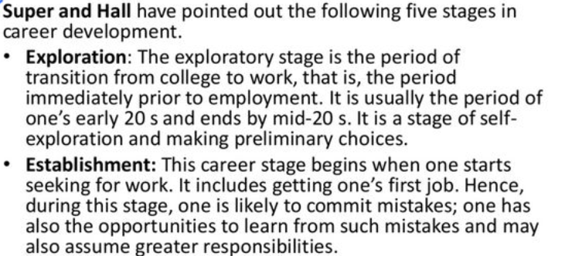
CAREER STAGE

Slide 10
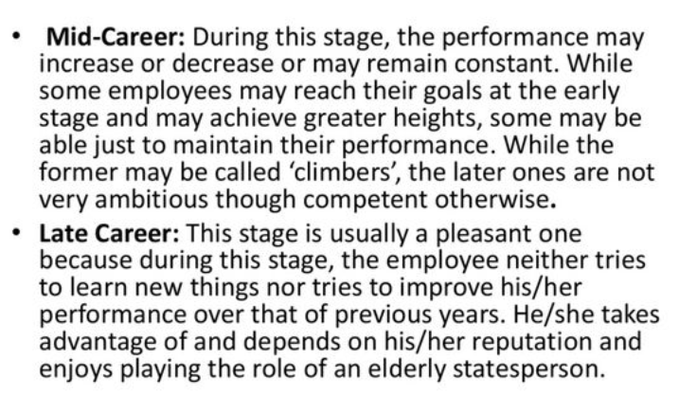

Slide 11
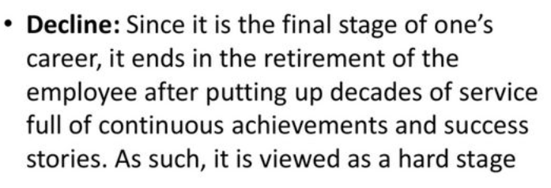

Slide 12
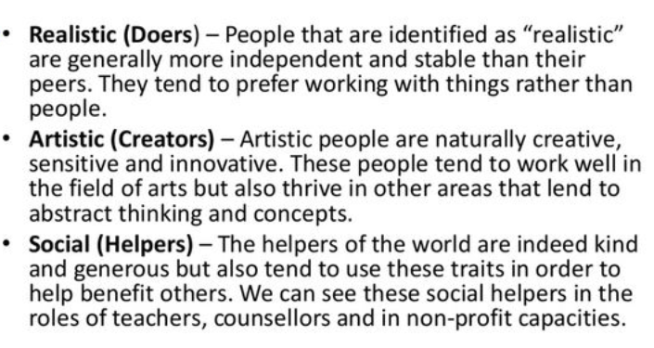
CAREER CHOICE

Slide 13
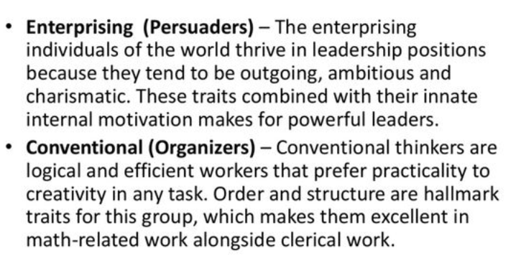

Slide 14
THANK YOU

